Slide 1
VIDES
INTERNATIONAL

Slide 2
OUR HISTORY
VIDES was born from the proposal of the Institute of the Daughters of Mary Help of Christians (FMA).
As such it is inserted in the journey of the FMA Institute and has as direct reference the Sector of the General Council for Youth Ministry.
It also collaborates with the areas for the Salesian Family, Mission ad Gentes, Formation, Social Communication and Administration

Slide 3
Vides international - NGO in special consultative status with the Economic and social Council and the department of Public Information of the United Nations

Slide 4
Retracing the history of VIDES and remembering years of walking in the company of young people is a sign of a reality that chooses to renew itself and adapt to the needs of today, while maintaining a solid and specific identity.

Slide 5
VIDES is the youth voluntary association of the FMA Institute which works for the promotion and defense of the rights of children, young people and women.

Slide 6
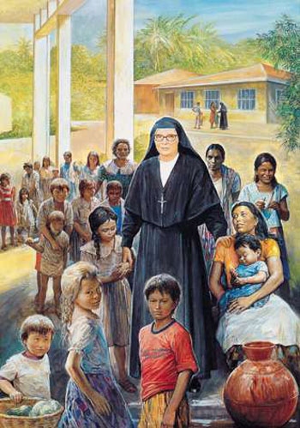
PATRONESS OF VIDES BL.MARIA ROMERO

Slide 7
: November 30, 1987 : The non-profit association VIDES is born in Italy
The stages
Following other VIDES realities are established all over the world. The first VIDES group in Europe was born in Portugal (1989)
while outside the European borders the Philippines are the first to have a VIDES member (1995). Today VIDES is present in 43 countries on 4 continents.

Slide 8
April 23, 1991:
VIDES is established and recognized by Belgian law as an international association (AISBL).
The stages
July 10, 1991:
Recognized as a Non-Governmental Organization (NGO) by the Ministry of Foreign Affairs.
November 30, 1998:
The General Council of the FMA deems it appropriate to distinguish two sites:
VIDES Italy, which coordinates the VIDES groups in Italy, and VIDES International, which coordinates all the VIDES groups in the world.

Slide 9
June 14, 2002: VIDES International is recognized as an NGO associated with the United Nations Department of Public Information (DPI-UN)
The stages
April 28, 2003:
The international VIDES obtains the Special Consultative Statute at the Economic and Social Council (ECOSOC) of the United Nations which allows to actively participate in the UN international forums.
September 20, 2006:
VIDES Internazionale promotes the Voluntary Youth and Solidarity Foundation ONLUS. With the ONLUS, VIDES strengthens its action in Italy in favor of solidarity and development
.

Slide 10
October 7, 2007:
After 20 years as director, Sr MariaGrazia Caputo (founder of VIDES) is assigned by the Mother General to a new post at the United Nations in Geneva. Sr Leonor Salazar, Mexican, was then appointed as the Institute's delegate for the VIDES International association and assumed the role of General Director.
The stages

Slide 11
The stages
12 April 2012:
VIDES is recognized as an NGO accredited to the United Nations International Labor Office (ILO)
1-4 November 2012: VIDES celebrates 25 years of activity with the X Conference: “Recall-Rejoice-Renew” in the presence of Mother General Yvonne Reungoat and the Rector Major Don Pascual Chávez

Slide 12
In 2016 VIDES International joined the FMA Network, a non-profit network promoted by the International Institute of the Daughters of Mary Help of Christians and made up of various Founding Associations, including VIDES International.
The stages

Slide 13
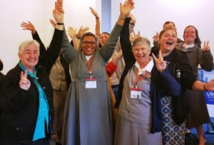
The stages
October 1, 2017: after 10 years as director, Sr. Leonor Salazar (General Director of VIDES) is assigned by the Mother General to a new position in Mexico. Sr. Annecie Audate, from Haiti is appointed as Delegate of the Institute for the International VIDES Association and assumes the role of General Director.

Slide 14
In November 2017, the VIDES Association celebrated its 30th anniversary.
The stages

Slide 15
It consists of 12 Executive Members
President
Vice President
Treasurer
Councilors

Slide 16
vides units in the province of st.thomas the apostle chennai inm 01. Kodambakkam – fatima convent 02. Chetpet – our ladys centre 03. viyasarpadi – auxilium convent 04. katpadi - auxilium college 05. katpadi - auxilium home 06. vellore – st.marys CONVENT VELLORE 07. arni – st.josephs convent 08. pallikonda – little flower convent 09. thiruppathur – mary immaculate convent 10. erode - mariyala 11. michaelpuram - auxilium home

